Slide 1
Recent Developments in
JTS and GEOS
Martin Davis CUGOS Spring Fling 2023
April 2023

Slide 2

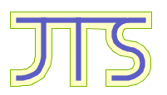


Martin Davis
martin.davis@crunchydata.com
Geospatial Engineer at
Developer on:
JTS Topology Suite
GEOS
PostGIS
pg_featureserv
I Math & Geometry!

Slide 3



JTS Topology Suite
Library for representing and processing vector geometry
Written in Java
Since 2001; now at version 1.19
Open source, on GitHub
License
EPL: Eclipse Public License
EDL: Eclipse Distribution License (BSD-style)
Widely used in Java spatial applications

Slide 4

GEOS Geometry Library
JTS port to C++ with a C API
Open source, on GitHub
License: GPL (GNU Public License)
VERY widely used
Language Bindings
Shapely (Python)
R-sf
GeoPHP
GoGEOS
Node-geos (Javascript)
rgeos (Rust)
Databases
PostGIS
SpatialLite
CockroachDB
DuckDB
MonetDB
Applications
QGIS
GDAL
MapServer
GRASS

Slide 5
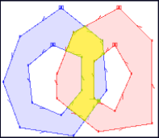
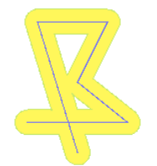
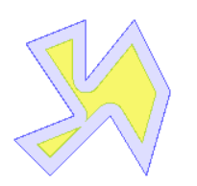
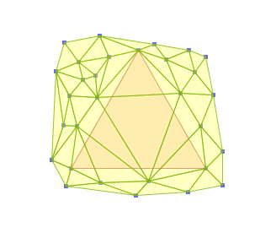
Functionality Overview
Provides the full OGC Simple Features for SQL geometry specification:
Points, Linestring, Polygons, collections
Metrics: Length, Area, Distance
Predicates: intersects, contains, etc.; relate for DE-9IM
Overlay: intersection, union, difference, symDifference
Constructions: Convex Hull, Buffer
Other functions:
Validation, Polygonization, Simplification, Linear Referencing, Delaunay/Voronoi…

Slide 6
Circles

Slide 7
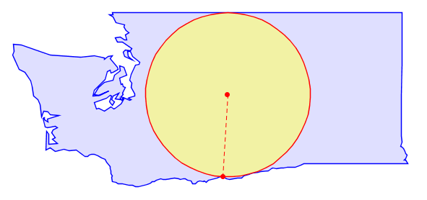
Maximum Inscribed Circle
Largest circle inside a polygon
Furthest point from polygon boundary
Iterative approximation - uses an accuracy distance tolerance
MaximumInscribedCircle( geom, accuracy );
Notes:
Fast to compute
Can be a pretty coarse representation for some geometries

Slide 8
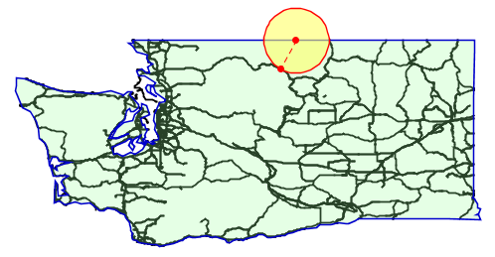
Largest Empty Circle
Largest circle containing no obstacles (lines / points)
Furthest point from obstacles
Optional: constrain center to a boundary polygon
LargestEmptyCircle( geom, [ boundary ], accuracy );
Notes:
Fast to compute
Can be a pretty coarse representation for some geometries

Slide 9
Hulls

Slide 10
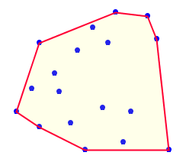
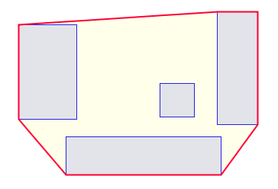
Convex Hull
The unique convex polygon containing input vertices
As per the Simple Features specification
Works for all geometry types
ConvexHull( geom );
Notes:
Fast to compute
Can be a pretty coarse representation for some geometries

Slide 11
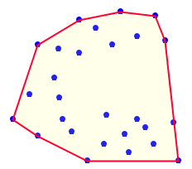
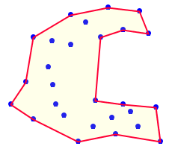
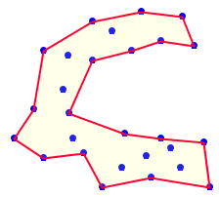
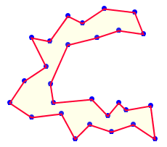
Concave Hull - Points
A (possibly) concave polygon containing input vertices
Many possible hulls, determined by param pctconvex
ConcaveHull( geom, pctconvex );
pctconvex= 1.0 0.6 0.4 0.0
Notes:
Concave Hull is computed by constructing a Delaunay Triangulation of the input points, then eroding outside edges in order of length, as long as they are longer than the tolerance distance
Pctconvex parameter is the fraction of the difference between the longest and shortest edges in the underlying Delaunay triangulation
Result is always a single, connected Polygon (never a MultiPolygon)

Slide 12
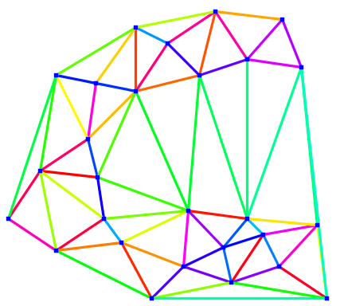
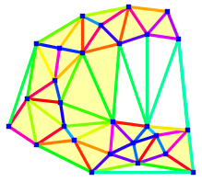
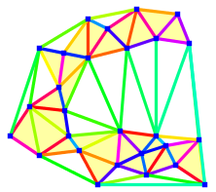

Concave Hull - Points: How it works
Build Delaunay Triangulation on points
Sort triangles by longest edge length
Remove triangles, until tolerance is reached
Pctconvex = 0.6 0.4 0.0
Notes:
Concave Hull is computed by constructing a Delaunay Triangulation of the input points, then eroding outside edges in order of length, as long as they are longer than the tolerance distance
Pctconvex parameter is the fraction of the difference between the longest and shortest edges in the underlying Delaunay triangulation
Result is always a single, connected Polygon (never a MultiPolygon)

Slide 13
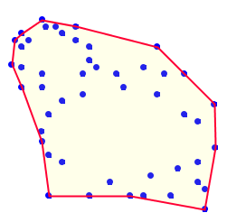
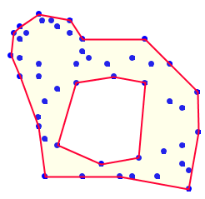
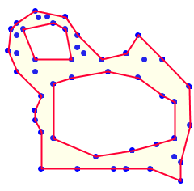
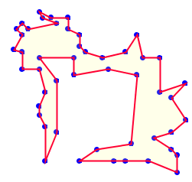
Concave Hull - Points, allowing holes
Concave hull can contain holes
via optional parameter allow_holes = true
ConcaveHull( geom, pctconvex, true );
pctconvex = 0.6 = 0.5 = 0.25 = 0.0
Notes:
Holes are always proper holes (they do not touch the polygon shell)

Slide 14
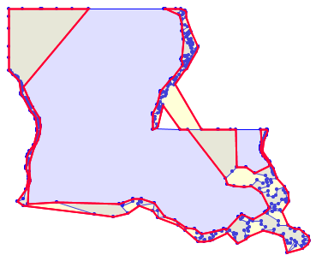
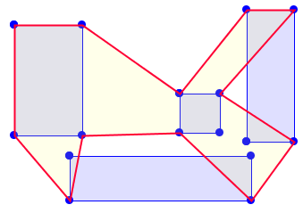
Concave Hull - Polygons?
Standard Concave Hull algorithms only support points
Problem! Does not respect polygon boundaries

Slide 15
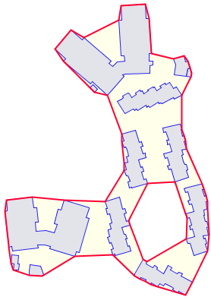
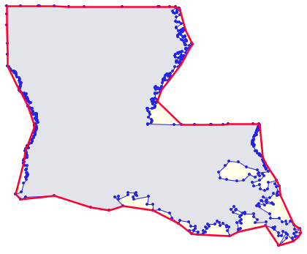
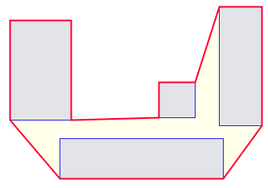
Concave Hull - Polygons
New algorithm to compute Concave Hull for polygon(s)
constrained by polygon boundaries
Notes:
Uses
Generalization for visualization or querying
Finding the “space between” polygons

Slide 16
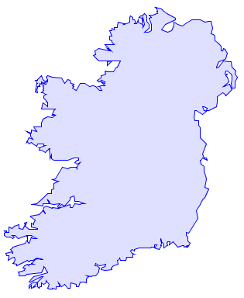
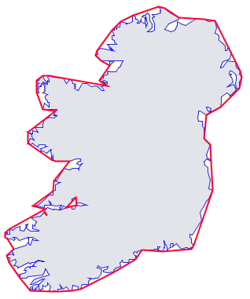
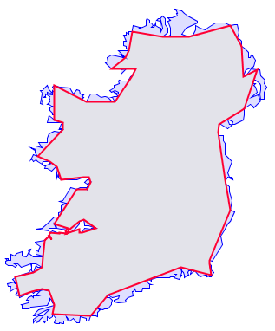
Polygon Hull Simplification
Computes Outer and Inner Hulls of polygonal geometry
Preserves polygonal topology, including holes and MultiPolygons
Parameter: vertex_fraction = fraction of vertices kept
SimplifyPolygonHull( geom, vertex_fraction, is_outer );
Input Outer Hull Inner Hull
Notes:
Uses:
Faster querying
Generalization

Slide 17
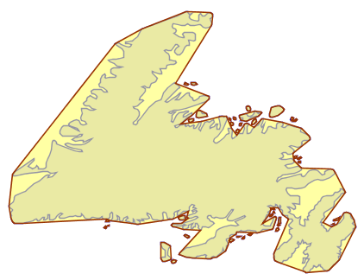
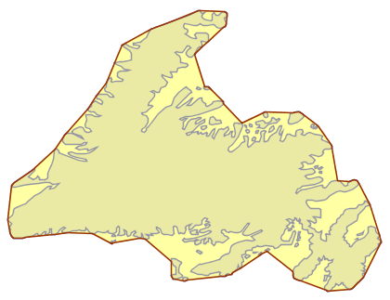
Polygon Outer Hull VS Concave Hull
Preserves Holes/MultiPolygon VS Single Polygon
Parameter: Vertex Fraction VS Percent Convex
Outer Hull
Vertex Fraction = 0
Concave Hull
PctConvex = 0.2

Slide 18
Triangulations

Slide 19
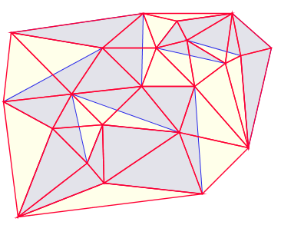
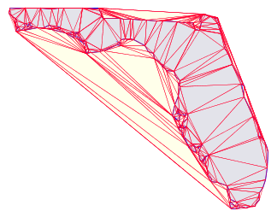
Delaunay Triangulation
Computes the Delaunay Triangulation of points
Processes vertices only
does not respect polygon linework
does not handle holes or MultiPolygons
SELECT ST_DelaunayTriangles( geom );

Slide 20
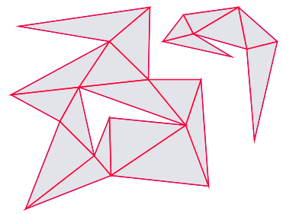
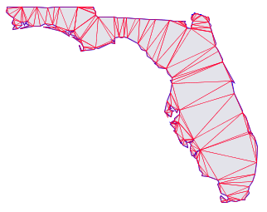
Polygon Triangulation
Computes the Constrained Delaunay Triangulation of polygons
respects polygon linework
handles holes and MultiPolygons
SELECT ST_TriangulatePolygon( geom );
Notes:
Uses
Polygon decomposition

Slide 21
Polygonal Coverages

Slide 22
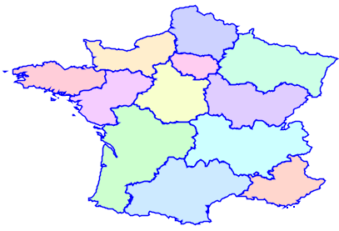
Polygonal Coverages
A set of non-overlapping polygons
Many use cases
Cadastral parcels
Political jurisdictions
Land use
Geological regions
Etc, etc
Can be represented as a full topological model
e.g. PostGIS Topology
Another option…

Slide 23
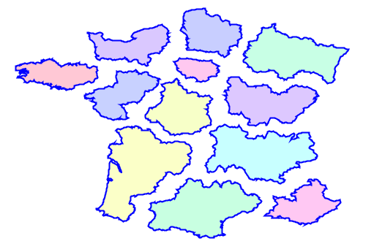
Simple Polygonal Coverage
Represent Polygonal Coverage as discrete polygons
A set of Polygons and MultiPolygons
Allows holes, disjoint regions
Implicit topology
Advantages
Simple
Performant
Works with existing functions

Slide 24
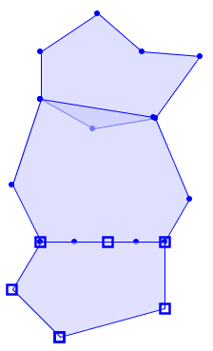
Polygonal Coverage - Validity
Coverage Validity required for:
Correct operation of coverage functions
Accurate modelling and analysis
A set of polygons is a valid coverage if:
Polygons are valid
Polygons are non-overlapping
interiors do not intersect
Adjacent polygons are edge-matched
shared lines have identical vertices
X
X

Slide 25
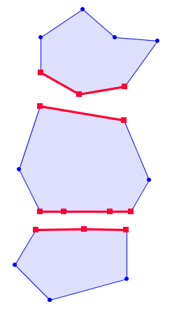
Polygonal Coverage - Validation
Tests if a set of valid polygons is a valid coverage
For coverage-invalid polygons, reports invalid sections of polygon boundary:
Overlapping edges
Non edge-matched adjacent edges
For each polygon returns
Invalid: invalid edges (MultiLineString)
Valid: empty or null
CoverageValidate( geom[] ) => MultiLineString[]

Slide 26
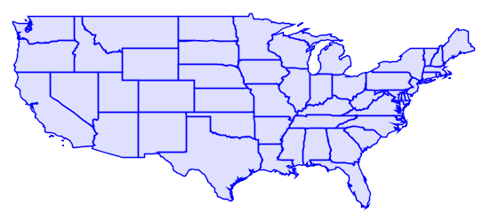
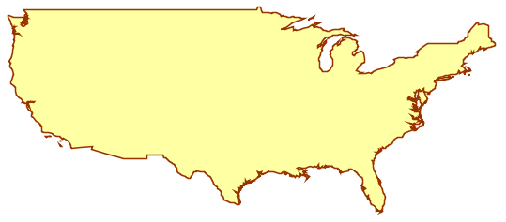
Polygonal Coverage - Union
Computes the union of a set of coverage polygons
Aggregate function, returns polygonal geometry
Very fast (can be 100x faster than general-purpose union)
CoverageUnion( geom[] ) => MultiPolygon

Slide 27
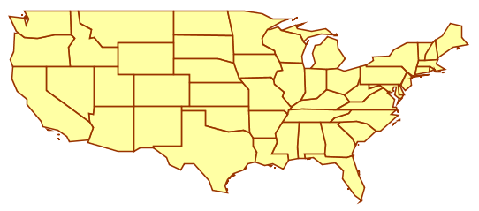
Polygonal Coverage - Simplification
Simplifies the boundaries of a set of coverage polygons
Preserves topology; result is a valid coverage with identical structure
CoverageSimplify( geom[], tolerance ) => geom[]
Size: 11,481 pts
Size: 739 pts

Slide 28
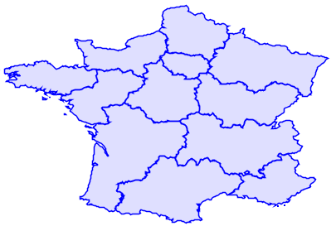
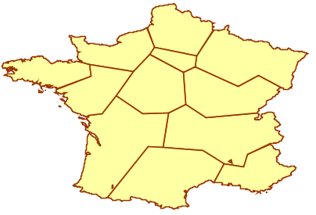
Polygonal Coverage - Inner Simplification
Simplifies the inside boundaries of a set of coverage polygons
Preserves topology; result is a valid coverage with identical structure
CoverageSimplifyInner( geom[], tolerance ) => geom[]

Slide 29
Future Work
Polygonal Coverage functions
Find Gaps
Clean
Precision Reduce
Overlay

